Slide 1


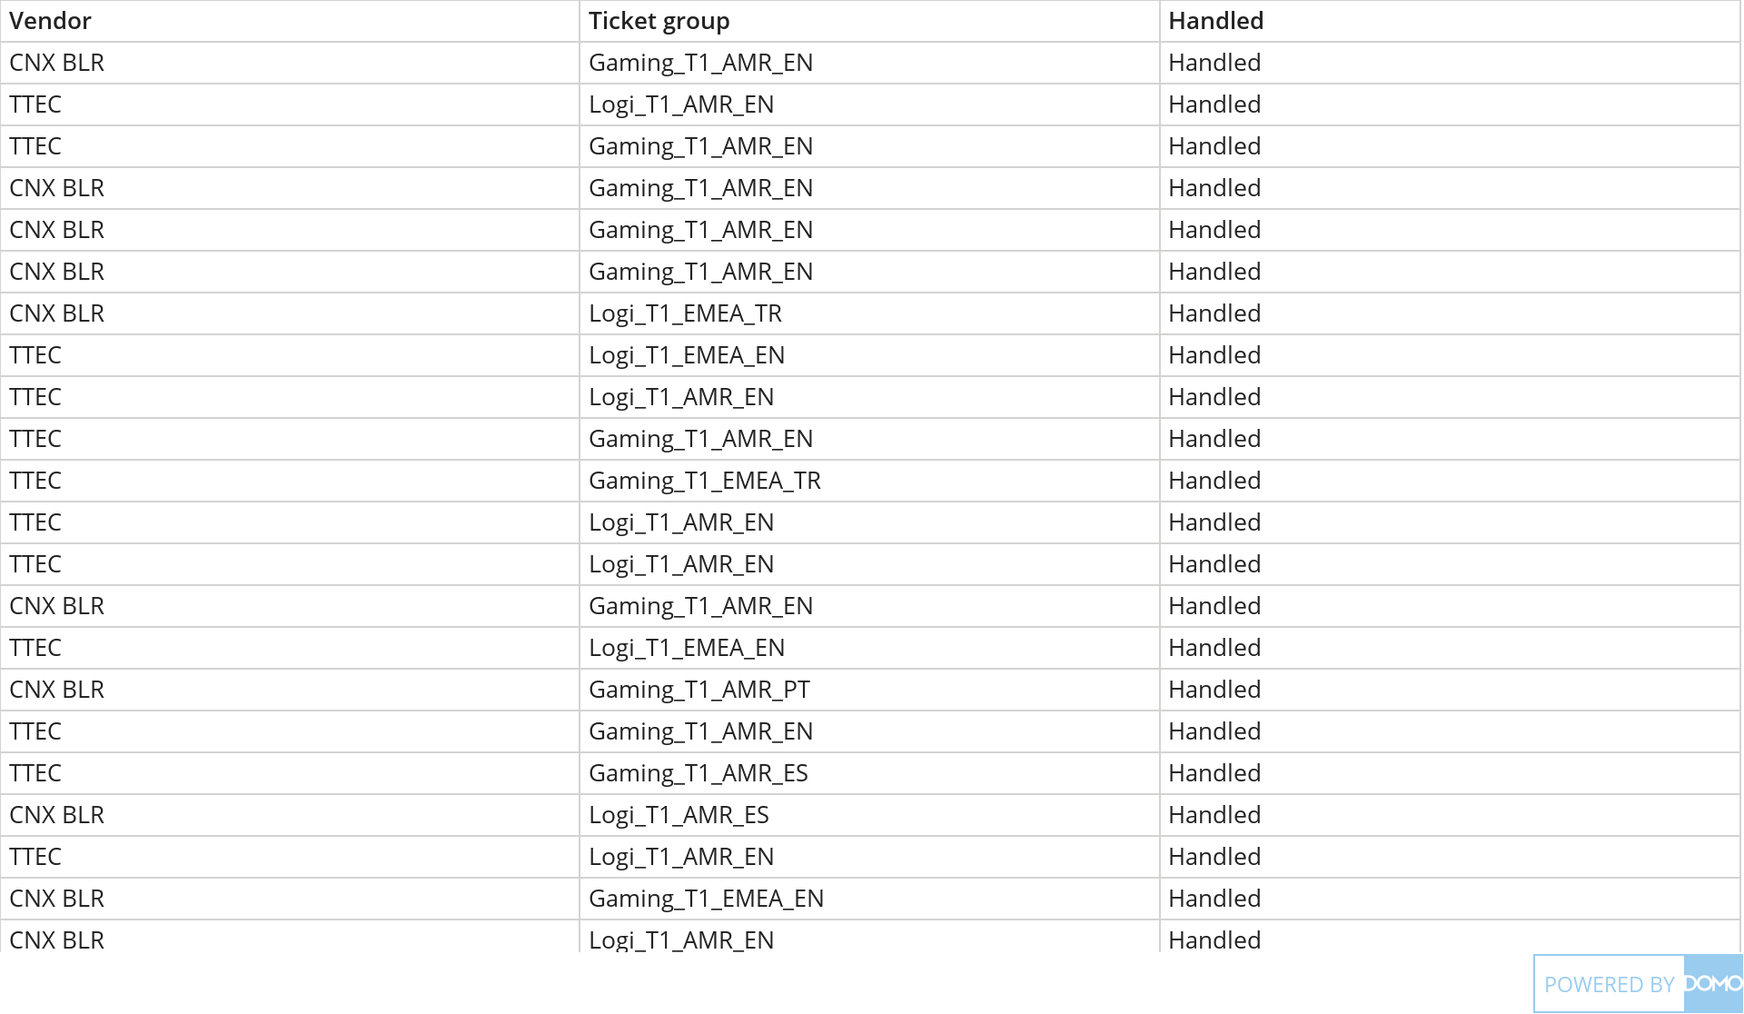
+
exported Apr 6, 2025, 12:54:00 AM MDT
CNX Volume data.xlsx
Jan 19, 2025 - Jan 20, 2025
9K Count of Ticket group

